Slide 1
poultry diseases 1
fourth stage
شعار الكلية
chapter two -clostridial disease in poultry
Dr.Harith Abdulla
Department of Pathology and Poultry Disease
College of Veterinary Medicine University of Basrah
University of Basrah- College of veterinary medicine- Department of Pathology and Poultry Disease

Slide 2
Introduction
Clostridia are among the most fascinating bacteria. The genus Clostridium consists of a diverse group of Gram-positive spore-forming anaerobic rods which are distributed worldwide. clostridial-caused diseases in poultry: ulcerative enteritis (UE), necrotic enteritis, botulism, and gangrenous dermatitis respectively caused by C. colinum, C. perfringens, C. botulinum, and C. septicum.

Slide 3
General Predisposing factors :
Predisposing factors include elements that directly change the physical properties of the gut, either damaging the epithelial surface, inducing mucus production, or changing gut transit times; factors that disrupt the gut microbiota; and factors that alter the immune status of birds.

Slide 4
specific predisposing factors
1-dietary changes: Sudden changes in feed composition can disrupt gut microbiota.Low fiber or coarse feed particles: These reduce mechanical digestion, leaving more nutrients for bacterial fermentation.
2-Antibiotic use: Overuse or misuse of antibiotics can disrupt the natural gut flora, allowing clostridial species to dominate.
3-Coccidiosis: Eimeria species damage the intestinal lining, providing a favorable niche for C. perfringens to invade and proliferate.

Slide 5
4-Poor litter quality: Wet, damp litter increases the risk of skin and gut infections by enhancing bacterial survival and spread.
.
5-Suboptimal ventilation: Poor airflow contributes to high ammonia levels, weakening respiratory and systemic immunity.

Slide 6
Ulcerative Enteritis(UE): or Quail Disease.
Ulcerative enteritis is a contagious clostridial disease that affects domestic and wild birds. It was first diagnosed in bobwhite quail (Colinus virginianus) and is also known as quail disease.It is an economically important disease in poultry production because of high mortality rates.Definition:
High infection and virulent disease characterized
by intestinal ulceration and liver necrosis caused
by Clostridium colinum.

Slide 7
Susceptibility:
Quail, Chickens and Turkeys. Epizootiology:
Transmitted by ingestion of contaminated feed, litter and water.
Symptoms
1-All ages are infected.
2-In acute case : Birds sometimes die without
any signs(symptomless).
3-In Chronic cases:
a- Listlessness.
b- Humped up and eyes partially closed.
c-Watery droppings containing urates.

Slide 8
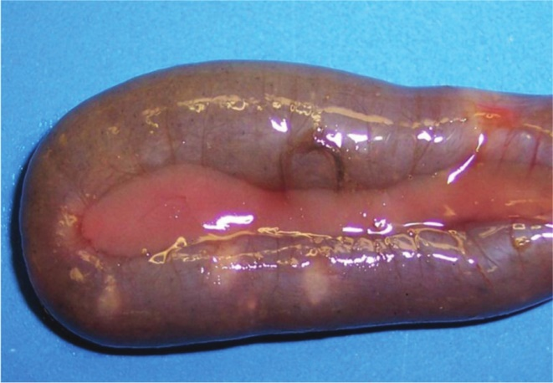
Post-mortem lesions:
1-In birds which die early: Lesions limited to
hemorrhagic enteritis of the upper portion of intestine.
2-Ulceration may occur in any portion of the intestine
and ceca.
3-Ulcers are small, yellow foci with hemorrhagic border,
and are visible on the serosal and mucosal surfaces,
they are Crater-like in shape.
4-Liver :Light yellow mottling with large irregular yellow area
of necrosis.
5-Spleen : Congested, enlarged and hemorrhagic.
Necrosis may also be present.
6-Lung: Congested, sometimes consolidated.

Slide 9
Histopathology:
1- Large focal areas of coagulation necrosis.
2- Granulocytic and lymphocytic infiltration.
Diagnosis:
1- Signs.
2-Lesions.
3-Bacterial isolation and identification.
4-Blood smears.
5-Histopathology.
Treatment: Amoxicillin, Lincomycin, Oxytetracycline/Doxycycline

Slide 10
Necrotic Enteritis:
The mechanism of infection of Necrotic Enteritis (NE) in poultry involves the proliferation of Clostridium perfringens in the gut and the production of toxins that damage the intestinal mucosa
Synonyms:
1-Rot gut.
2-Crud gut.
3-Cauliflower gut.
Definition:
Is an acute disease which produces destruction
of the intestinal lining of the digestive tract.
Caused by Clostridium perfringens type C.

Slide 11
Clinical signs:
1-Age : 6-8 week-old chickens.
2-Rapid loss of condition(Emaciation).
3-Anorexia.
4-Blood-stained feces.
Post-mortem lesion:
1-Thickening of distal third of small intestine,
lumen containing bloody exudates.
2-Necrotic layer adheres to the surface or in the
lumen of small intestine.
3-The liver is congested.

Slide 12
Diagnosis: ( As in Ulcerative Enteritis).
Treatment: ( As in Ulcerative Enteritis).

Slide 13
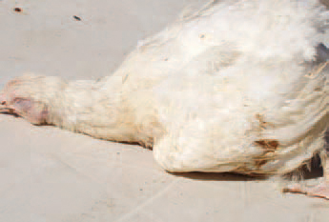
Botulism:
Synonyms:
1-Limberneck.
2-Western Duck Sickness.
3-Duck Disease.
4-Bullbar Disease.
Definition:
Acute intoxication of fowl caused by ingestion of
spoiled food contain toxin produced by Clostridium
botulinum, characterized by flaccid paralysis of the
neck, weakness and prostration.

Slide 14
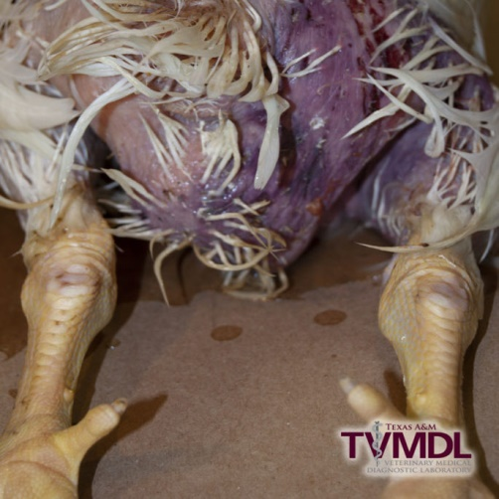
Gangrenous Dermatitis:
Synonyms:
1-Skin necrosis.
2-Wing rot.
Definition:
Necrosis of the skin and deeper tissues caused
by several species of clostridial bacteria.

